Slide 1
Dynamical Decoupling a tutorial
Daniel Lidar
QEC11

Slide 2
For a great DD tutorial see Lorenza Viola’s talk in
http://qserver.usc.edu/qec07/program.html
Slides & movie.
This tutorial:
Essential intro material
High order decoupling
Decoupling along with computation

Slide 3
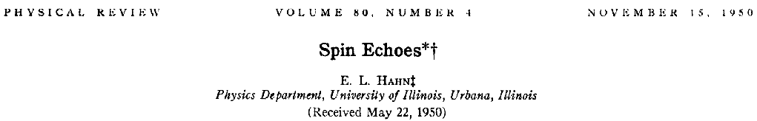
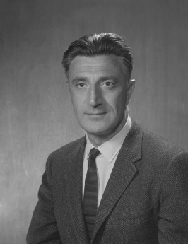
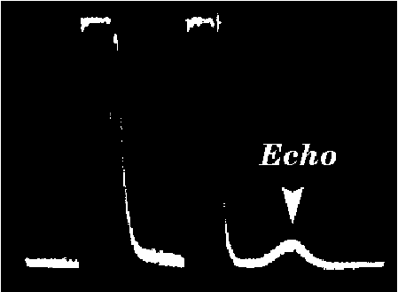
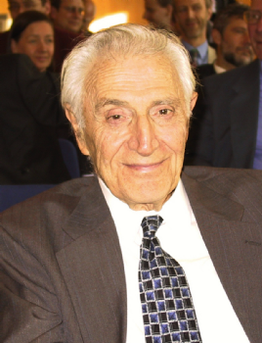
Origins: Hahn Spin Echo

Slide 4

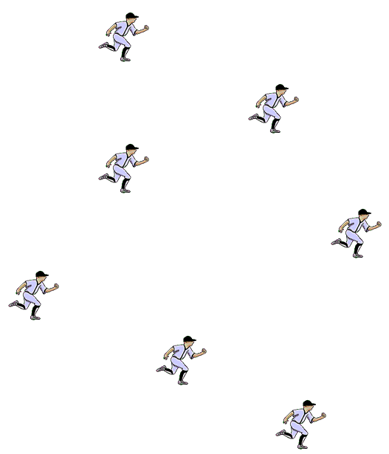


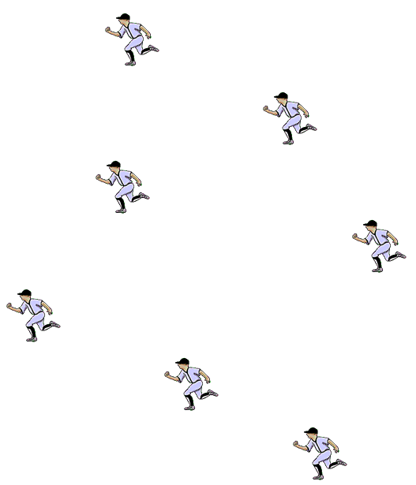
Overcoming dephasing via time-reversal
Usain Bolt
Lidar

Slide 5
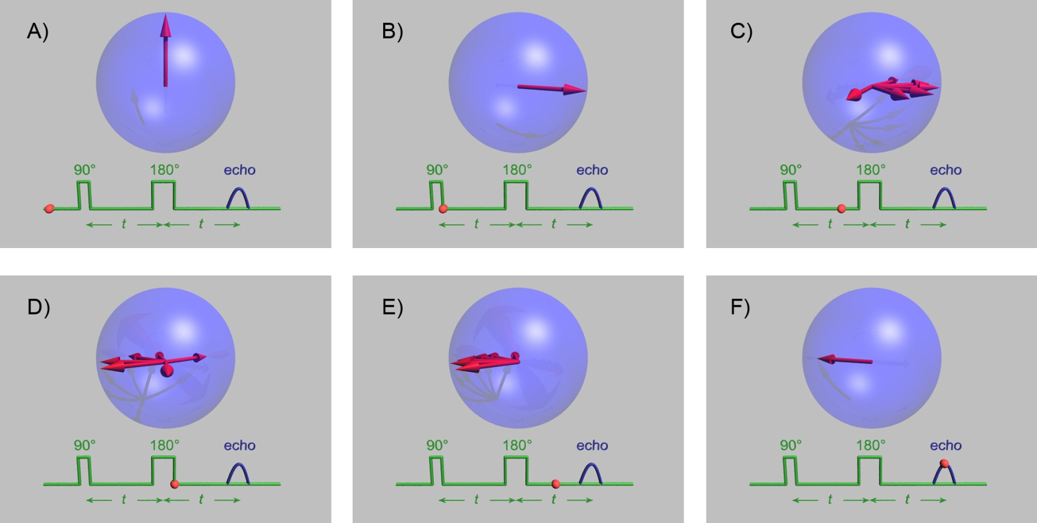
Time reversal without time travel
http://en.wikipedia.org/wiki/Spin_echo

Slide 6
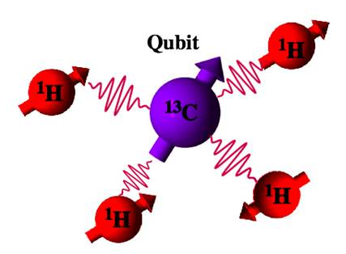
Modern Hahn Echo experiment (Dieter Suter)

Slide 7
Let’s get serious: the general setting
Hamiltonian error model
Joint evolution of system (S) and bath (B); noise Hamiltonian H
“free evolution”
This talk: all Hamiltonians bounded in the operator norm (largest singular value)
This assumption is not necessary: norms may diverge (e.g., oscillator bath) Often it pays to use correlation functions instead.
See, e.g., Mike Biercuk’s and Gonzalo Alvarez’s talks

Slide 8






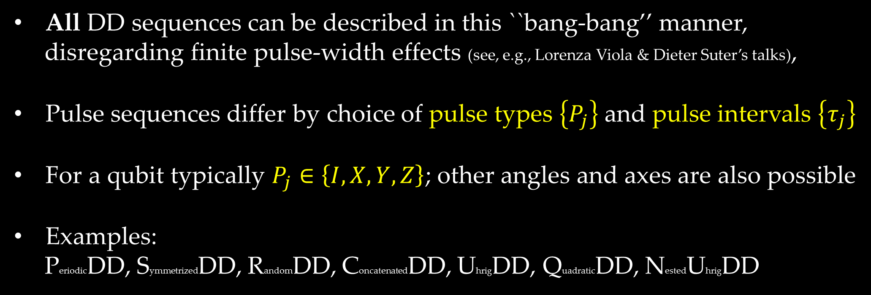

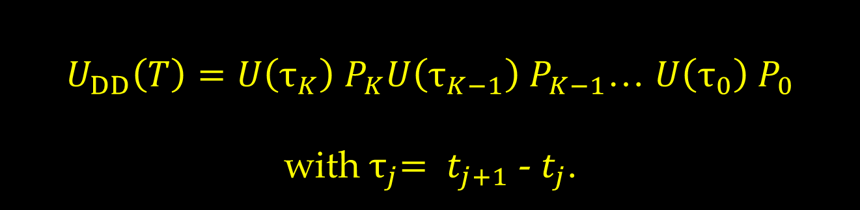


DD: just a set of interruptions
Consider a set of instantaneous unitaries$\left\{P_{j}\right\}$ applied to the system only at times$\left\{t_{j}\right\},$inbetween free evolutions:
$U_{DD}\left(T\right)=U\left(τ_{K}\right) P_{K}U\left(τ_{K−1}\right) P_{K−1}$… $U\left(τ_{0}\right) P_{0}$
with${ τ}_{j}= t_{j+1}$ - $t_{j}$.
$$P_{0}$$
$$P_{1}$$
$$P_{2}$$
$$P_{j}$$
$${ τ}_{0}$$
$${ τ}_{1}$$
$${ τ}_{2}$$
…
$${ τ}_{j}$$
t
All DD sequences can be described in this ``bang-bang’’ manner,
disregarding finite pulse-width effects (see, e.g., Lorenza Viola & Dieter Suter’s talks),
Pulse sequences differ by choice of pulse types $\left\{P_{j}\right\}$and pulse intervals $\left\{τ_{j}\right\}$
For a qubit typically $P_{j}∈\left\{I,X,Y,Z\right\}$; other angles and axes are also possible
Examples:
PeriodicDD, SymmetrizedDD, RandomDD, ConcatenatedDD, UhrigDD, QuadraticDD, NestedUhrigDD

Slide 9














How good does it get?
At the end of the pulse sequence:
$U_{DD}\left(T\right)=exp⁡[−i{TH}_{∅} + \sum_{α}{H_{α,eff} O(T^{N_{α}+1})]}$
$H_{∅}$is the component of $H$ that commutes with a$ll pulses$
$H_{α,eff}$ are the remaining errors; they can be computed using, e.g., the Magnus or Dyson series
$N_{α}$ is the ``decoupling order’’ of the ``α–type’’ error
$$P_{0}$$
$$P_{1}$$
$$P_{2}$$
$$P_{j}$$
$$P_{K}$$
$${ τ}_{0}$$
$${ τ}_{1}$$
$${ τ}_{2}$$
$${ τ}_{j}$$
…
$${=U}_{DD}\left(T\right)$$
$$t_{0}$$
$$T$$
t
The fundamental min-max problem of DD:
Maximize $N={\text{min}}_{α}N_{α}$’s while minimizing $K$

Slide 10
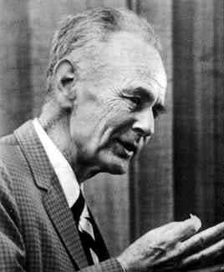
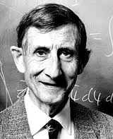
Magnus & Dyson
Wilhelm Magnus
1907-1990
Freeman Dyson
1923-
relevant for DD after transformation to ``toggling frame” (rotates with pulse Hamiltonian)

Slide 11

(small piece of) The DD pulse sequence zoo
the price $K$ for one qubit the payoff $N$
PeriodicDD $≤4$ 1
SymmetrizedDD $≤8$(twice PDD) 2
ConcatenatedDD $O{(4}^{N})$ $N$
UhrigDD $O(N)$ (single error type only) $N$
QuadraticDD $O(N^{2})$ $N$
sequence length & min decoupling order

Slide 12
PDD: first order decoupling & group averaging
free evolution:
Apply pulses via a unitary symmetrizing group
repeat: “periodic DD”

Slide 13
PDD: first order decoupling & group averaging
free evolution:
Apply pulses via a unitary symmetrizing group
repeat: “periodic DD”
pulses

Slide 14
PDD: first order decoupling & group averaging
free evolution:
Apply pulses via a unitary symmetrizing group
pulses

Slide 15
PDD: first order decoupling & group averaging
free evolution:
Apply pulses via a unitary symmetrizing group
commutes with all the pulses:
“G-symmetrization”
first order decoupling
higher order terms:

Slide 16



Example 0: Hahn echo revisited – suppressing single-qubit dephasing
$$τ$$
$$τ$$
0
$$T=2τ$$
t
commutes with G;
undecoupled
anti-commute with G;
decoupled to 1st order;
``detected” by G

Slide 17



Example 1: ``Universal decoupling group” – suppressing general single-qubit decoherence
$$τ$$
$$τ$$
$$τ$$
$$τ$$
0
$$T=4τ$$
t
decoupled to 1st order;
``detected” by G

Slide 18

(small piece of) The DD pulse sequence zoo
the price $K$ for one qubit the payoff $N$
PeriodicDD $≤4$ 1
SymmetrizedDD $≤8$ (twice PDD) 2
ConcatenatedDD $O{(4}^{N})$ $N$
UhrigDD $O(N)$ (single error type only) $N$
QuadraticDD $O(N^{2})$ $N$
sequence length & min decoupling order

Slide 19
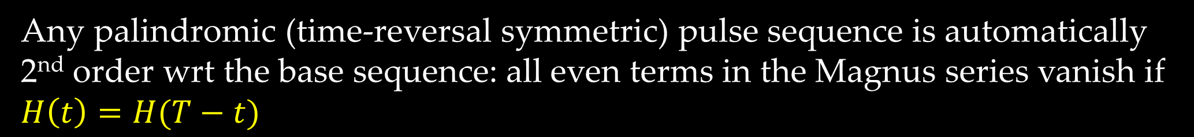
(small piece of) The DD pulse sequence zoo
the price $K$ for one qubit the payoff $N$
PeriodicDD $≤4$ 1
SymmetrizedDD $≤8$ (twice PDD) 2
ConcatenatedDD $O{(4}^{N})$ $N$
UhrigDD $O(N)$ (single error type only) $N$
QuadraticDD $O(N^{2})$ $N$
sequence length & min decoupling order
Any palindromic (time-reversal symmetric) pulse sequence is automatically 2nd order wrt the base sequence: all even terms in the Magnus series vanish if $H\left(t\right)=H(T−t)$

Slide 20









Example 2: Palindromic suppression of general single-qubit decoherence to second order
$$τ$$
$$τ$$
$$τ$$
$$2τ$$
$$τ$$
$$τ$$
$$τ$$
$$τ$$
0
$$T=8τ$$
t
decoupled to 2nd order:

Slide 21
The quest for high order
How do we go systematically beyond second order decoupling?
Two general techniques:
Concatenation (CDD)
Pulse interval optimization (UDD, QDD, NUDD)

Slide 22





Concatenated DD
$$τ$$
$$τ$$
$$τ$$
$$τ$$
0
$$T$$
t

Slide 23
Concatenated DD
0
$$T$$
t
Same as the original problem, so apply $p_{1}$ again, keeping T fixed, shrinking $τ$:

Slide 24
Concatenated DD
0
$$T$$
t
Same as the original problem, so apply $p_{1}$ again, keeping T fixed, shrinking $τ$:
…

Slide 25
Concatenated DD
0
$$T$$
t
Same as the original problem, so apply $p_{1}$ again, keeping T fixed, shrinking $τ$:
Alternatively: keep $τ$ fixed, then $T=4^{k}τ \overset{⇒}{}$ optimal concatenation level:

Slide 26
(small piece of) The DD pulse sequence zoo
the price $K$ for one qubit the payoff $N$
PeriodicDD $≤4$ 1
SymmetrizedDD $≤8$ (twice PDD) 2
ConcatenatedDD $O{(4}^{N})$ $N$
UhrigDD $O(N)$ (single error type only) $N$
QuadraticDD $O(N^{2})$ $N$
sequence length & min decoupling order

Slide 27

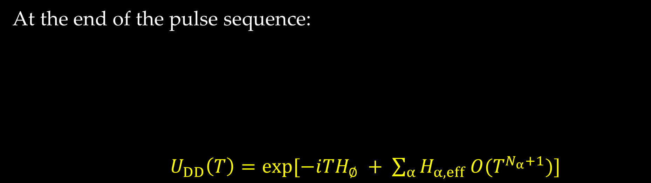
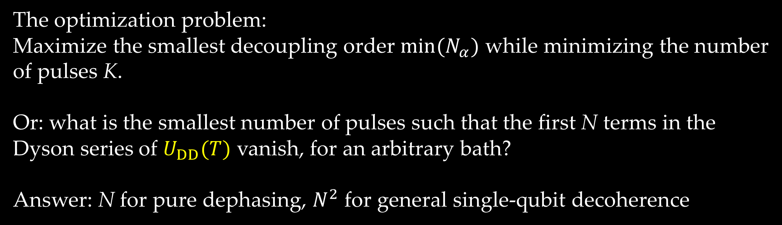

More for Less
CDD requires exponential number of pulses for given decoupling order.
Can we do better?
At the end of the pulse sequence:
$U_{DD}\left(T\right)=exp⁡[−i{TH}_{∅} + \sum_{α}{H_{α,eff} O(T^{N_{α}+1})]}$
$$P_{0}$$
$$P_{1}$$
$$P_{2}$$
$$P_{j}$$
$$P_{K}$$
$${ τ}_{0}$$
$${ τ}_{1}$$
$${ τ}_{2}$$
$${ τ}_{j}$$
…
$${=U}_{DD}\left(T\right)$$
$$t_{0}$$
$$T$$
t
The optimization problem:
Maximize the smallest decoupling order $min⁡(N_{α})$ while minimizing the number
of pulses K.
Or: what is the smallest number of pulses such that the first N terms in the
Dyson series of $U_{DD}(T)$ vanish, for an arbitrary bath?
Answer: N for pure dephasing, $N^{2}$ for general single-qubit decoherence

Slide 28

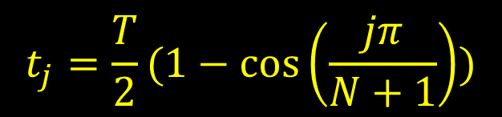
Uhrig DD: choose those intervals well
Suppresses single-axis decoherence to Nth order with only N pulses
  Optimal for ideal pulses, sharp high-frequency cutoff
= X pulse
divide semicircle into N+1 equal angles
$$t_{N}$$
$$t_{j}=\frac{T}{2}(1−\cos\left(\frac{jπ}{N+1}\right))$$
Notes:
Circle center is at T/2, has radius T/2. Distance from t=0 to projection t_j on t axis is (T/2)(1-cos(2\theta_j)) = (T/2)[2sin^2(\theta_j)] = Tsin^2[j\pi/(2(N+1))]

Slide 29
How about general qubit decoherence?
Quadratic DD (QDD):
a nesting of two types (e.g., X and Z) of UDD sequences.

Slide 30
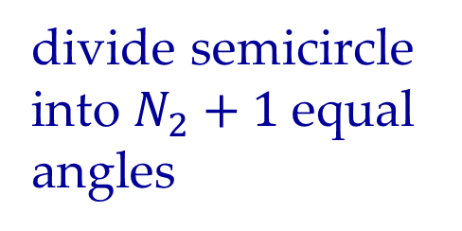
How about general qubit decoherence?
Quadratic DD (QDD):
a nesting of two types (e.g., X and Z) of UDD sequences.
divide semicircle into $N_{2}+1$equal angles

Slide 31

How about general qubit decoherence?
Quadratic DD (QDD):
a nesting of two types (e.g., X and Z) of UDD sequences.
divide semicircle into $N_{2}+1$equal angles
divide each small semicircle into $N_{1}+1$equal angles

Slide 32
How about general qubit decoherence?
Quadratic DD (QDD):
a nesting of two types (e.g., X and Z) of UDD sequences.
Uses (N₁ +1)(N₂ +1) pulses to remove the first min(N₁ , N₂) orders in Dyson series
Proof: talk by Liang Jiang (Wed. 2:40)

Slide 33
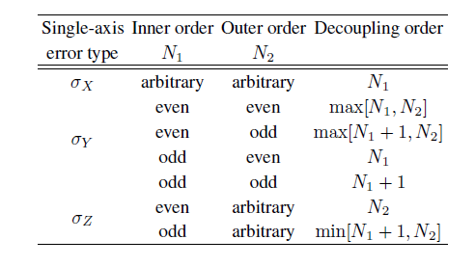

How about general qubit decoherence?
Quadratic DD (QDD):
a nesting of two types (e.g., X and Z) of UDD sequences.
Uses (N₁ +1)(N₂ +1) pulses to remove the first min(N₁ , N₂) orders in Dyson series
Proof: talk by Liang Jiang (Wed. 2:40), poster by Wan-Jung Kuo
Decoupling order of each error type :
$$N_{α}−1$$
not both even
Further nesting: NUDD, useful for multi-qubit DD

Slide 34
(small piece of) The DD pulse sequence zoo
the price $K$ for one qubit the payoff $N$
PeriodicDD $≤4$ 1
SymmetrizedDD $≤8$ (twice PDD) 2
ConcatenatedDD $O{(4}^{N})$ $N$
UhrigDD $O(N)$ (single error type only) $N$
QuadraticDD $O(N^{2})$ $N$
sequence length & min decoupling order

Slide 35
DD sequences battle it out numerically
J. R. West, B. H. Fong, & DAL, PRL 104, 130501 (2010).
D=averaged trace-norm distance between initial and final system-only state.
Initial state is random pure state of system & bath. Bath contains 4 spins.

Slide 36
DD & Computation
Problem: DD pulses interfere with computation – they cancel everything!
How can they be reconciled?
At least three approaches:
Decouple-while-compute
Decouple-then-compute
Dynamically corrected gates (see Lorenza Viola’s talk at 3 today)

Slide 37
DD & Computation
Problem: DD pulses interfere with computation – they cancel everything!
How can they be reconciled?
At least three approaches:
Decouple-while-compute
Decouple-then-compute
Dynamically corrected gates (see Lorenza Viola’s talk at 3 today)

Slide 38

Decouple-while-compute
Need pulses and computation to commute
Solutions:
Use encoding and stabilizer/normalizer structure
Use double commutant structure of noiseless subsystems
E.g.:
- DD pulses are the stabilizer generators of a stabilizer code:
$$U_{DD}\left(T\right)=exp⁡[−i{TH}_{∅} + \sum_{α}{H_{α,eff} O(T^{N_{α}+1})]}$$
$H_{∅}$ consists of the logical operators of the stabilizer code
- DD pulses are collective rotations of all qubits
${ H}_{∅}$ consists of Heisenberg exchange interactions;
used, e.g., to demonstrate high fidelity gates for quantum dots

Slide 39
DD & Computation
Problem: DD pulses interfere with computation – they cancel everything!
How can they be reconciled?
At least three approaches:
Decouple-while-compute
Decouple-then-compute
Dynamically corrected gates (see Lorenza Viola’s talk at 3 today)

Slide 40
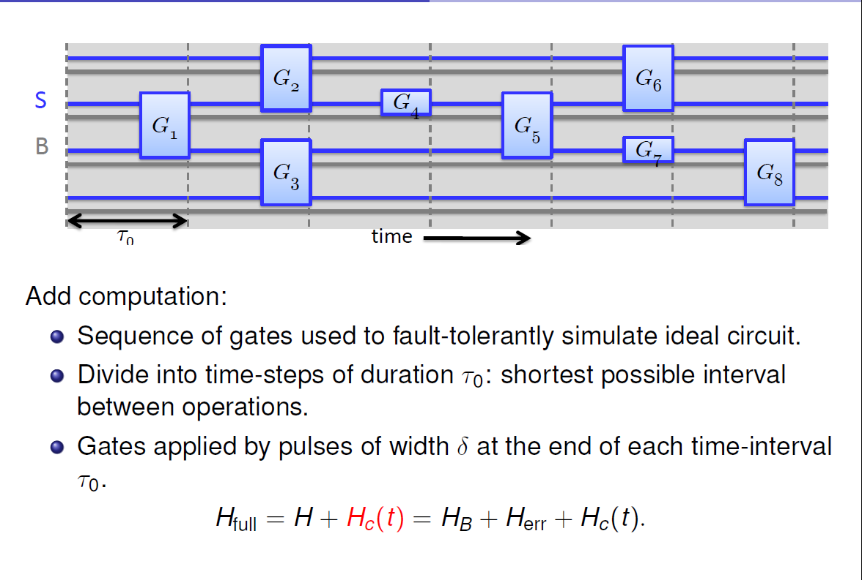
Consider a fault-tolerant simulation of a circuit

Slide 41
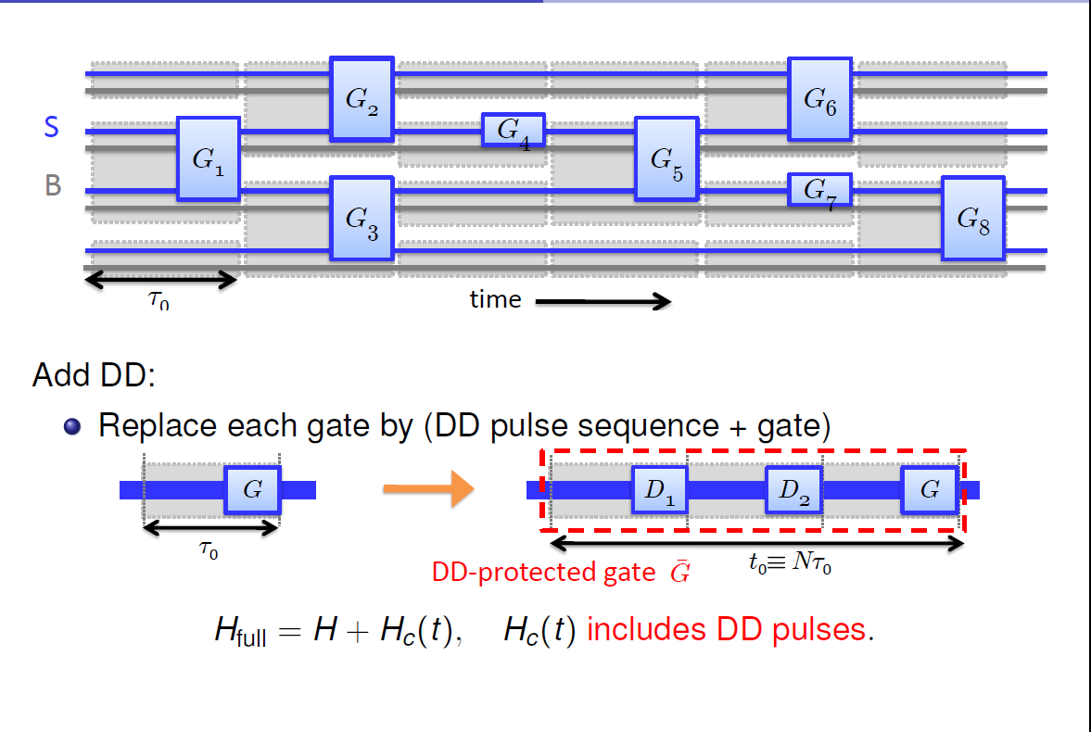
Now prepend DD: decouple-then-compute
T
$U_{DD}\left(T\right)=exp⁡[−i{TH}_{∅} + \sum_{α}{H_{α,eff} O(T^{N_{α}+1})]}$

Slide 42
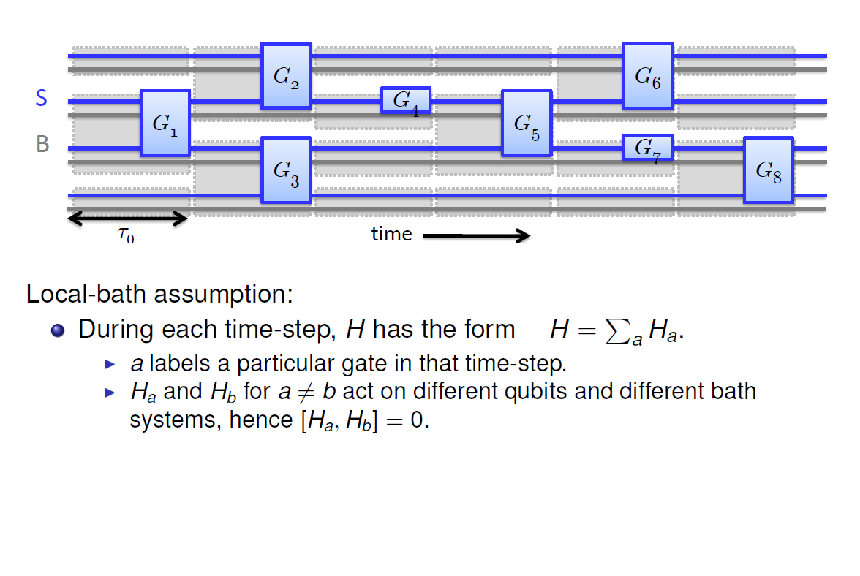
Noise strengths can be upper-bounded for a well-behaved bath
→ allows us to examine each DD-protected gate separately.
actually this assumption can be relaxed: see Gerardo Paz’s talk, 3:40

Slide 43
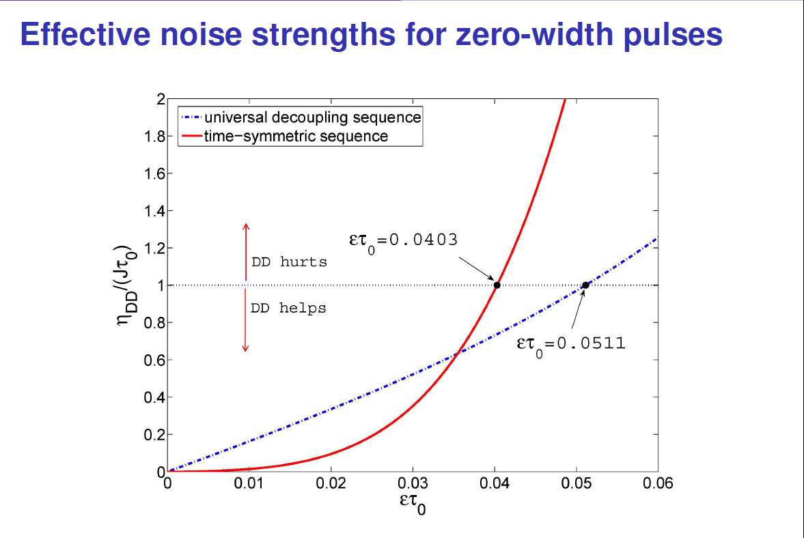
DD-protected gates can be better
H.-K. Ng, DAL, J. Preskill, PRA 84, 012305 (2011)

Slide 44
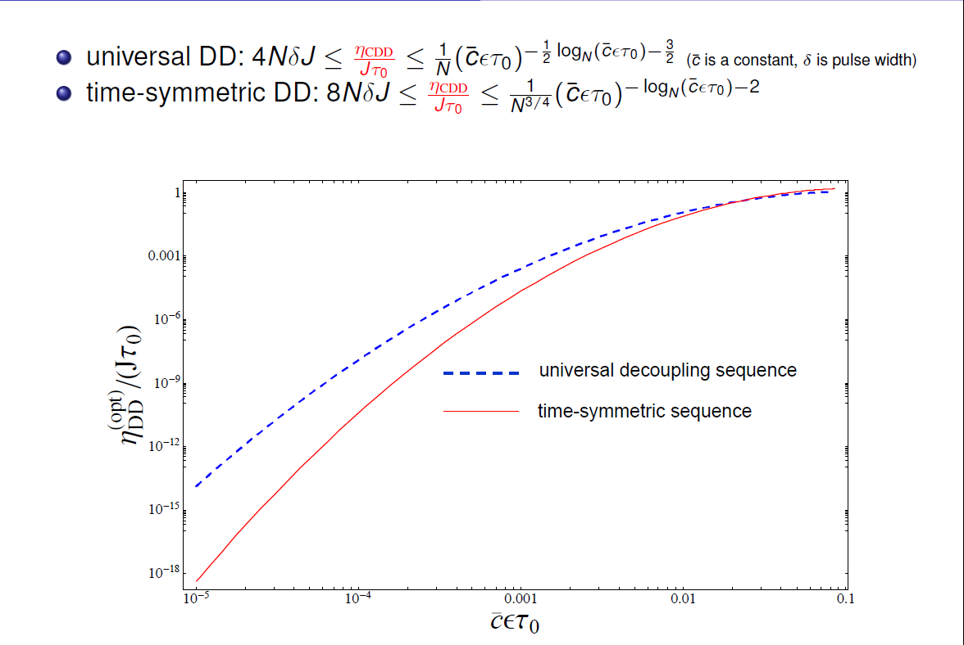
CDD-protected gates can be even better
H.-K. Ng, DAL, J. Preskill, PRA 84, 012305 (2011)

Slide 45
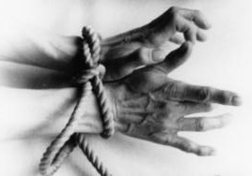
Fighting decoherence with hands tied
Dynamical decoupling is
A method where one applies fast & strong control pulses to the system
Open-loop, feedback- and measurement-free
Dynamical decoupling is not
A stand-alone solution
It cannot, by itself, be made fault-tolerant (see Kaveh Khodjasteh’s talk Thu 2:40)
So, why not use the full power of fault-tolerance?
Open-loop is technically easier than closed-loop or topological methods
DD can be used at the lowest (physical) level to improve performance
  and reduce overhead of fault tolerance
DD has been widely experimentally tested, with encouraging results

Slide 46
Essential references for this talk
L. Viola, S. Lloyd PRA 58, 2733 (1998): first DD paper
L. Viola, E. Knill, S. Lloyd, PRL 82, 2417 (1999): General theory of DD
P. Zanardi Phys. Lett. A 258, 77 (1999): General theory of DD, DD as symmetrization
K. Khodjasteh, D.A. Lidar, PRL 95, 180501 (2005): first CDD paper
F. Casas, J. Phys. A 40, 15001 (2007): convergence of Magnus expansion
G. S. Uhrig, PRL 98, 100504 (2007): first UDD paper
W. Yang, R.-B. Liu, PRL 101, 180403 (2008): first proof of universality of UDD
J. R. West, B. H. Fong, D.A. Lidar, PRL 104, 130501 (2010): first QDD paper
Z. Wang, R.-B. Liu, PRA 83, 022306 (2011): first NUDD paper
H.-K. Ng, D.A. Lidar, J. Preskill, PRA 84, 012305 (2011): DD and fault tolerance, derivation of Magnus series; proof of vanishing even orders of Magnus for palindromic sequences
W.-J. Kuo, D.A. Lidar, PRA, 84 042329 (2011): first complete proof of universality of QDD; see Wan’s poster

